Slide 1

Xperdyte Advanced Manufacturing for Sage Partner & Sage Evolution

Slide 2

Xperdyte Manufacturing for
Sage Partner & Sage Evolution
is a cost-effective solution for improved manufacturing resource planning.

Slide 3
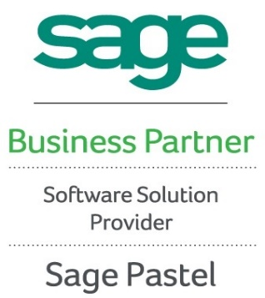
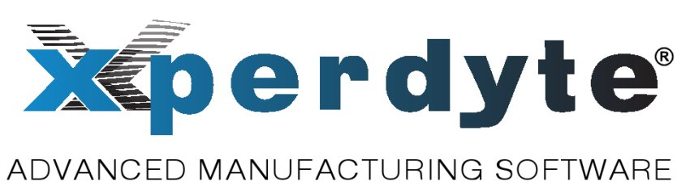
Xperdyte
Sage Integration
Xperdyte Manufacturing offers a seamless integration with the Sage Partner &
Sage Evolution Core Modules.
Xperdyte Manufacturing extracts the raw materials from Sage Partner & Sage Evolution into Work in Progress.
Takes control of all the cost elements during the production cycle.
Finished Goods are then returned, accurately costed into Sage Partner & Sage Evolution’s finished goods inventory.
Manufacturing variances and efficiencies are posted to a manufacturing variance account in Sage Partner & Sage Evolution’s General Ledger.
“What's measured improves” ~ Peter F. Drucker

Slide 4
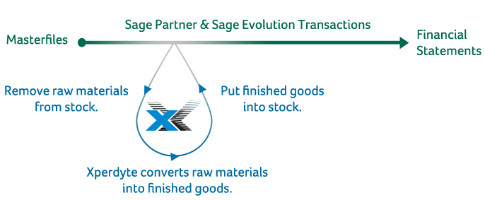
Xperdyte
Integration Flowchart
(Sage Evolution & Sage Partner)
"The most dangerous kind of waste is the waste we do not recognize." ~ Shigeo Shingo

Slide 5
Xperdyte
Software Design
Xperdyte
Bill of Materials
Work In Progress
Material Requirement Planning
Production Scheduling
Quality & Statistical Process Control
Xperdyte Manufacturing
uses five primary modules
to manage and control your
production processes
“Financially, the overruns are much less
important than the overdue” ~ Eliyahu M. Goldratt

Slide 6
Xperdyte
5 Pillars of Measurement
Xperdyte Manufacturing uses standards to measure variances against actuals:
Bill of Materials/Works Orders
  Standard v Actual is compared item by item in the 6 cost elements, namely, Work Centre, Machine Setup Time, Material, Labour, Buyout and Other costs
Material Requirements Planning
  Historical projected quantities are compared to actual quantities on hand per time period.
Production Scheduling
  Actual start and end times are monitored against scheduled times – results are colour coded for easy interpretation.
Quality & Statistical Process Control
  Quality and Statistical Process Control results are monitored against standards.
“If you’re not keeping score, you’re just practicing”
~ Vince Lombardi

Slide 7
Xperdyte
Industry Types
Xperdyte Manufacturing for Sage Partner & Sage Evolution is an ideal solution for most
manufacturing industries:
Chemical Blending
Health and Beauty Care Products
Paint Producers
Paper and Foil Converters
Steel and Metal Working
Textiles
Plastics and Moulding
Cosmetics and Pharmaceuticals
Wood Working
Electronics
Food and Beverage
Engineering
And more…
“When you are finished changing, you're finished.” ~ Benjamin Franklin

Slide 8
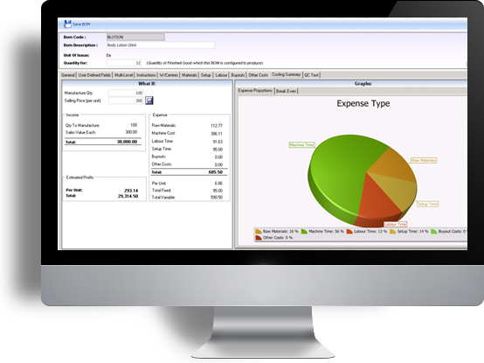
Xperdyte
Bill of Materials
Multi-Level Bill of Materials
The Multi-level Bill of Materials offer advanced costings which form the base for setting standards against which Works Orders are measured for complete and accurate control of your production activities
True Marginal Costing
Allocation of all costs as Fixed or Variable
cost types.
Compensation for yield losses.
Powerful ‘what-if’ costing scenario
functionality, applying marginal costing techniques.
“If you tell me what you are going to measure, I will tell you how I am going to behave”
~ Kenneth E. Kirby

Slide 9
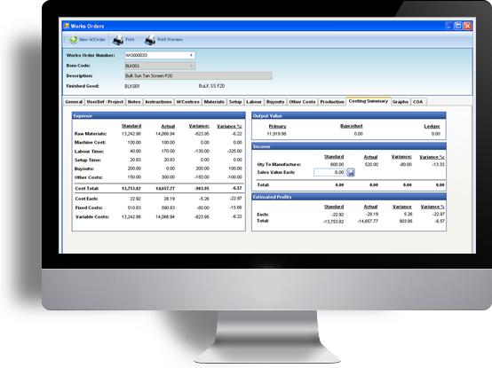
Xperdyte
Work Orders & Work In Progress
Works Orders control the actual running and measurement of performance of jobs in production.
Product routing through works centres.
Prioritization of Works Orders.
Compare actual performance against
pre-determined standards.
Allows barcode scanning for production feedback.
Bi-product output can be recorded and costed
“Measure what can be measured and monitor what can’t”
~ Peter F. Drucker

Slide 10
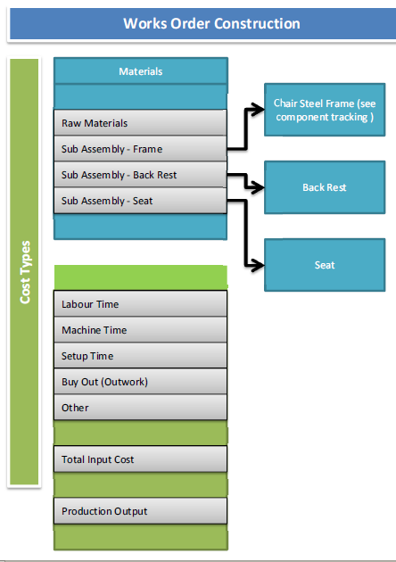
Xperdyte
Work Orders Construction
“Efficiency is doing things right; effectiveness is doing the right things.” ~ Peter F. Drucker

Slide 11
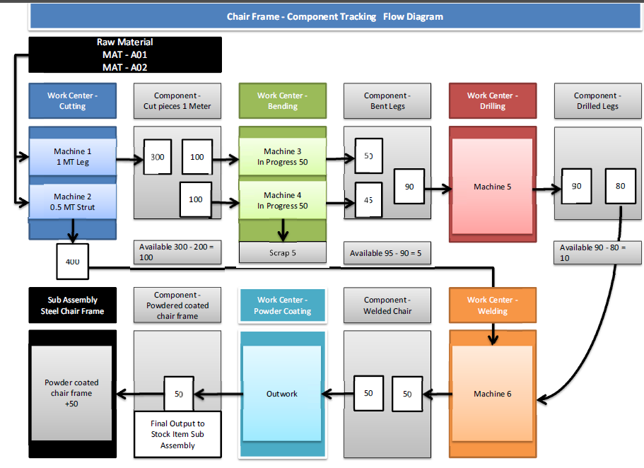
Xperdyte
Work Orders Component Tracking
“"Efficiency is intelligent laziness." - David Dunham

Slide 12
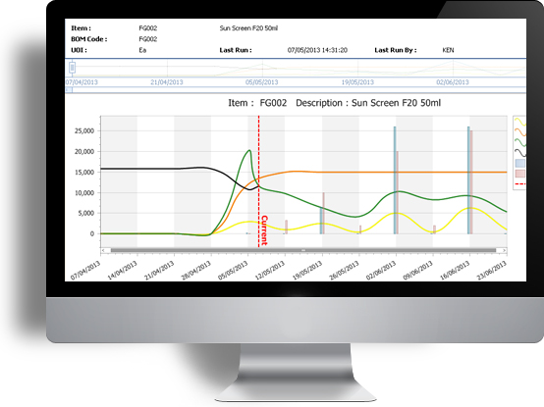
Xperdyte
Material Requirements Planning
(MRP and MRPII)
The Xperdyte Manufacturing MRP modules simultaneously achieves four objectives
Xpernomics Graphing
To ensure that materials are available for production and products are available for customers.
Maintain the lowest possible material and production levels in store.
Plan manufacturing activities, delivery schedules and purchasing activities.
Xpernomics Graphing plots the future inventory optimization plan as well as retaining historical results for analysis.
“If you can't measure it, you can't manage it” ~ Peter F. Drucker

Slide 13
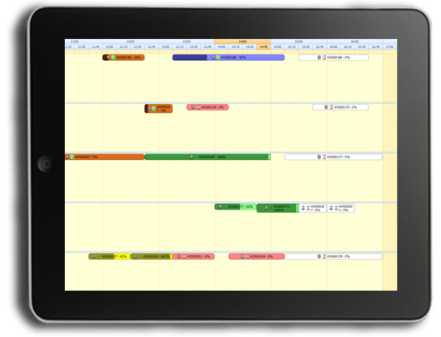
Xperdyte
Production Scheduling
Xperdyte Manufacturing offers an interactive Production Scheduling calendar which allows Works Orders to be scheduled at Work Centre level.
Graphical representation of scheduling is effortless.
Touch Screens can be used to view tasks and enter feedback from the factory floor.
Users can drill down to the machine and operators performing the works order with start and stop times.
“If you need a new process and don't install it, you pay for it without getting it” ~Ken Stork

Slide 14
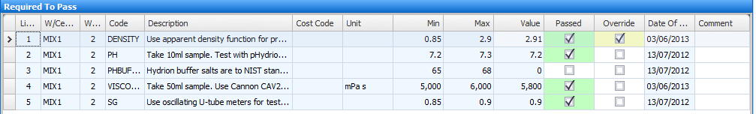
Xperdyte
Quality Control
Quality Control
  Create and set tests with tolerance levels and result parameters
    Per Lot number and/or per work centre
  Xperdyte will produce Laboratory and Certificate of Analysis reports (COA)
“If you don't have time to do it right you must have the time to do it over” ~Author Unknown

Slide 15
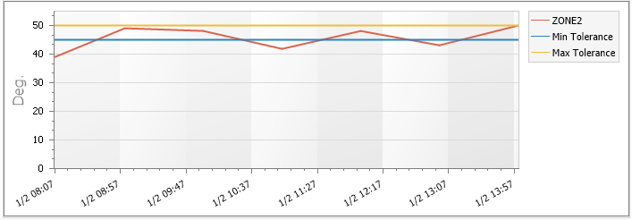
Xperdyte
Statistical Process Reporting
Statistical Process Reporting
  Set minimum and maximum tolerance levels per zone per work centre
  Xperdyte will produce printed and graphed results
“The measurement system directly affects employee performance” ~ Gerhard Plenert & Bill Kirchmier

Slide 16
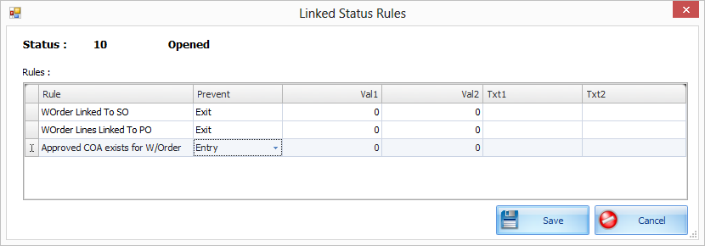
Xperdyte
Workflow via Status Control
Workflow Control
  Works Order movement through work centre's is controlled by Status “exit and entry” rules
  Scheduling is controlled by the Purchase Order due date of critical items
“It is more than probable that the average man could, with no injury to his health, increase his efficiency fifty percent” ~Walter Scott

Slide 17
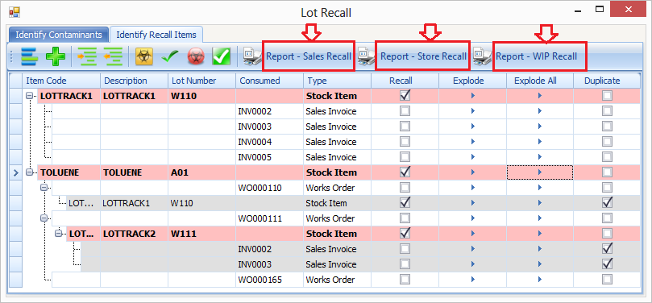
Xperdyte
Lot Recall
Lot Recall Tool (Not Available in Partner only in Evolution)
  This determines the recall of items that are or contain contaminants from Customers (Items already sold), Production (Items in WIP) and Stores (Raw Materials)
“It is not necessary to change. Survival is not mandatory.”
~ W. Edwards Deming

Slide 18
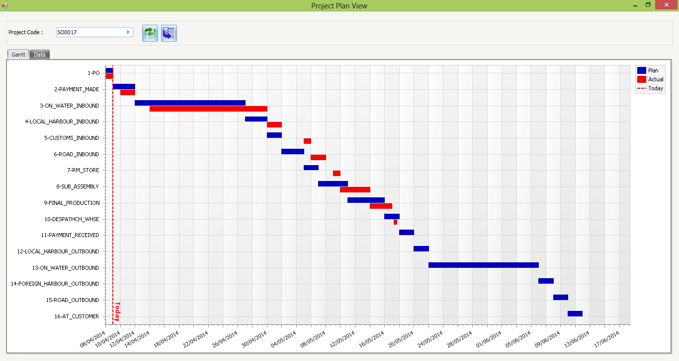
Xperdyte
Project Planning Milestones
Project Planning Milestones
  Allows for the creation of project milestones where forecast plans can be set and measured against actual performance. These can also be viewed using Xperdyte’s Web Application Dashboard.
“The way to get started is to quit talking and begin doing.”
~ Walt Disney -

Slide 19
Xperdyte
Additional Software Features
BOMs & Works Orders
  Unlimited Specifications
  Attach unlimited documents
  Serial Number/Lot Tracking for traceability from cradle to grave
    Requires Sage Evolution Serial Number and Lot Tracking modules
  Global replacement tool
  Multi level Works Order creation
  Buyouts with Supplier processing
  Worker productivity tracking
  Sales Order tracking via Works Order status
General
  Landing page dashboard
  User access control
  Project Tracking
  User Defined Fields on:
    Inventory
    BOMs & Works Order Headers
    BOMs & Works Order Lines
      Includes 2 unlimited size text fields
    Projects
    SPC Tests
  Decanting facility
Reporting
  Extensive Reports
  Document reprinting
  Built in Report Designer to modify any document or report in Xperdyte
“Where there is no Standard there can be no Kaizen
(Change for the Better)” ~ Taiichi Ohno

Slide 20
Xperdyte
Contact Details
  Xperdyte Contact details:
  Email Address: ken@xperdyte.co.za
  Website: www.xperdyte.co.za
  Reseller Contact details:
  Email Address:
  Website:
  Telephone:
  Contact Person:
“Without changing our patterns of thought, we will not be able to solve the problems that we created with our current patterns of thought.”
~ Albert Einstein

Slide 21
Thank you for your time
“The goal is not to improve one measurement in isolation. The goal is to reduce operational expenses AND reduce inventories AND increase throughput simultaneously”
~ Eliyahu M. Goldratt, The Goal
“Lean Manufacturing is a production strategy aimed toward achieving the shortest possible cycle time and reducing the expenditure of resources by eliminating waste” ~ Gemba Academy

